Slide 1
Key NumPy Concepts

Slide 2
NumPy Motivation
Vectors and matrices are central to data science.
Usually in vector/matrix form: input data, parameter values, model outputs
Data science workflows demand fast, user-friendly operations on vectors and matrices.
Linear algebra operations
Filtering, element-wise arithmetic, aggregation, etc.
Notes:
Why do we need numpy? Simply put, vectors and matrices are everywhere in data science.
data is often in matrices, model parameters are in vectors or matrices, outputs are often in vectors or matrices.
When you work as a data scientist, you have to perform a lot of matrix operations.
you need linear algebra operations multiplication, inverses, etc
you also need to do data wrangling on matrices, including filtering, arithmetic, and applying functions.
you need these operations to be user-friendly, and you also need them to be fast
(by fast, I really mean that working with python lists just isn’t fast enough - for modern applications, we need something faster)

Slide 3
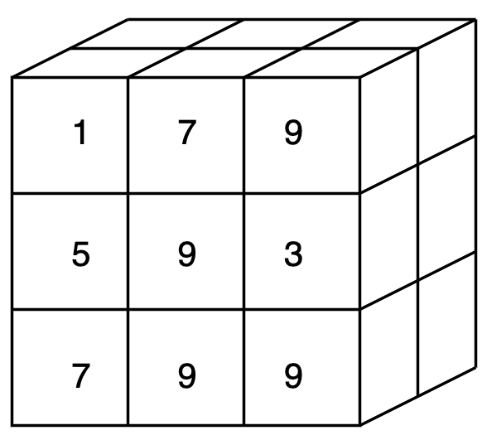
The NumPy Array
Class ndarray: represents an array of numerical or Boolean data
One- or multi-dimensional
Computations are fast
Notes:
The numpy solution is a class called an numpy array.
the exact name is ndarray for n dimensional array. this is numpy’s representation of a vector or a matrix.
It has methods for a lot of linear algebra and other common matrix operations.
and it’s very efficient, often an order of magnitude more efficient than lists.

Slide 4
Why Is NumPy Fast?
list: built for flexibility
Can hold any object
Can hold a mix of types
Wide range of methods
array: built for performance
Holds specialized types
All items must have same type
Restricted set of methods
[ , ]
list
5
7.4
int
float
memory loc. | 304 | 305 | 306 | ...
data | 00101101 | 00111001 | 01111101 | ...
index | 0 | 1 | 2 | ...
Notes:
So why is numpy so fast?
Let’s look at a python list and an a numpy array side-by-side.
The list is built for flexibility.
Remember that a list is referential. the objects it contains are somewhere else in memory. This lets a list hold any object, and the objects can be of varied types. But there is a cost to this. python needs extra time to follow these references and figure out the types of objects.
The array is built for computational speed.
Under the hood, an array puts all of its items next to each other in memory. each item takes the same amount of space.
You can only do this with specialized types, and all items must be the same type.
The benefit is speed. For example, you can get to any item you want very quickly by calculating its memory address. A lot of calculations can be highly optimized.
On the other hand, the array is less flexible. you don’t have the same range of methods that a list has.

Slide 5
Vectorized Operations
Vectorization: performing an operation on an entire array without explicit loops
Example: to add 1 to each item in an array
data_array + 1
Notes:
another idea that makes numpy fast and useful is vectorization.
Vectorization is the idea that you perform operations on an array as a whole. you don’t have to write loops that pass through each item individually.
Here’s a simple example. if you want to add 1 to every item in a numpy array, you should nt write down a loop.
Instead, just write the name of the array plus 1. Python understands that this +1 is intended to be element-by-element, it will automatically add 1 to every element.
You can see that this is much more compact than write a loop.
You might wonder, is this just a syntax that hides a loop? In other words, dopes python still implement a loop under the hood?
The answer is yes, there will still be looping under the hood. but it will be very optimized. The code will be written in C for speed, and the operations will be split up across different processors.

Slide 6
Functional Programming
1.3
4.5
2.3
5.8
+ 1
normalize
max
1.5
Notes:
One last concept at the heart of numpy is functional programming.
This is a programming philosophy that emphasizes the use of functions to transform data. So it’s different than the object oriented programming we saw earlier.
Actually an advocate for functional programming might argue that objects are a bad thing, because having state hidden in different classes is confusing and can lead you to make errors.
Instead, they might argue that it’s better to keep all the state confined inside tables, and use functions to transform those tables.
You can agree or disagree. but when you program with numpy, you will naturally tend to use a functional style.
Your data will be in an array, then you apply a sequence of functions to it, and you get another array.
It’s important that this sequence is reproducible. You should always get the exact same answer, and there should be no side effects anywhere else in the program.
This can help make your code more transparent / more readable and keep you aware of everything you’re doing.

Slide 7
Key NumPy Concepts

